Slide 1

Mid-Term Mini-Hackathon
Sanchit Singhal
Sonakshi Garg

Slide 2

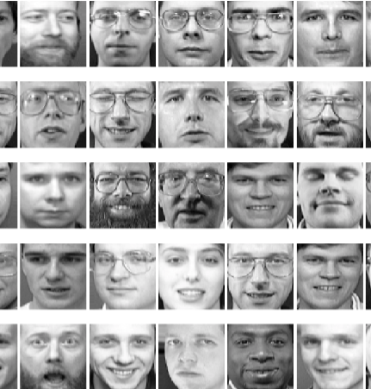
THE PROBLEM
Data contains 238 images (64 x 64 pixels) => 238 Observations X 4096 features
There are 3 arrays:
Faces: an array containing flattened images, i.e., a series of 4096 pixel intensities.
FaceImages: an array containing 64 x 64 images
y: an indicator variable of whether the person is wearing glasses (1: glasses, or 0: no glasses)
Build a classifier to determine whether a person is wearing glasses or not

Slide 3
SOLUTION/APPROACH TO THE PROBLEM
Used a supervised learning algorithm since we had an output variable ‘Y’
Used PCA to reduce high dimensionality (4096 features)
Created Classifiers using RandomForest, Logistic Regression and Support Vector Machines

Slide 4
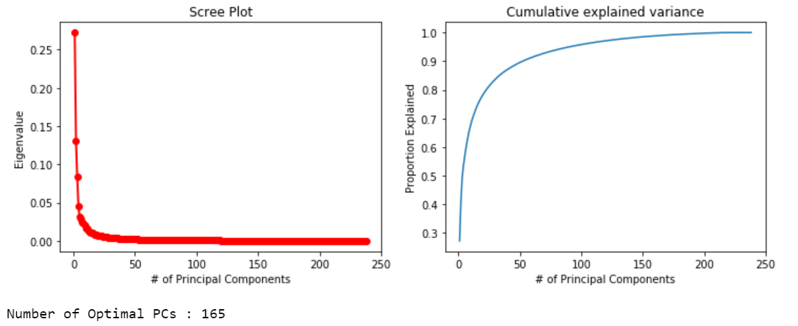
PCA - to reduce high dimensionality
Number of optimal components were determined to explain > 99% variance

Slide 5

RESULTS/OUTPUTS

Slide 6
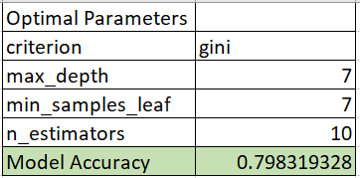
Classification Model 1 : Random Forest
Hyperparameter values used to estimate optimal parameters:
Criterion: ['entropy','gini’]
n_estimators: [1,5,7,10]
max_depth:[4,5,6,7,8]
min_samples_leaf: [1,2,3,4,5,6,7,8]

Slide 7
Classification Model 2 : Logistic Regression
Hyperparameter values used to estimate optimal parameters:
C: [.001, 0.01,.1,1,10,100,1000]
penalty':['l2’]
solver':['newton-cg','lbfgs','liblinear','sag','saga']

Slide 8
Classification Model 3 : Support Vector Machine
Hyperparameter values used to estimate optimal parameters:
C: [.001, 0.01,.1,1,10,100,1000]
degree:[1,2,3,4,5,6]
kernel: ['linear', 'rbf', 'poly’]
gamma:['auto','scale']
coef0:[0,1,2,3]
Highest accuracy amongst the 3 models

Slide 9
THANK YOU

